Slide 1
TRIBAL APPAREL
ⓣ

Slide 2
1.
Intro
Business Model

Slide 3
2.
Project Details
Costing and estimated time.

Slide 4
Estimated Time
Planning and info collecting-
Around 20 to 30 days needed to accomplish this part.
Total System Development
We need 1 month to develop total Business system.
Buying and Selling management-
Around 15 days needed to accomplish this part.

Slide 5
Estimated Cost
Planning and info collecting-
Approximately BDT 10k needed to make proper plan and collect info properly
Employment Cost
As we’re planning for online shop only so all we need some delivery man and employer for online support. It’ll cost initially 30k.
Office Rent-
Initially 30k needed for office and product storage.
Producing and buying cost-
20k to 30k is enough for beginning.

Slide 6
3.
Marketing
Business Model

Slide 7
ONLINE MARKETING
ADVERT PRODUCT IN FACEBOOK
ADVERT IN GOOGLE ADSENSE
SHARING IN GROUPS
ADVERT IN BUY-SELL SITES
IN OUR OWN WEBSITE & FB PAGE
PROMOTIONAL OFFERS
OFFLINE MARKETING
ADVERT IN PRINT MEDIA
USING POSTER AND STICKERS
BRANDING IN UNIVERSITIES AND COLLEGES
ALLURING INTERNATIONAL BUYERS

Slide 8
PROFIT MODEL
MARKETING COST
Major budget is for marketing.
Such as, around 20% to 30% cost of selling price will be used for advertising.
OTHER COST
Around 20% to 25% of selling price will go to other cost
PROFIT
After all kinds of cost 20% to 30% of the selling price will be the total profit.
Producing & buying cost
Around 30% to 40% of selling price will go to other cost

Slide 9

4.
Strength, Weakness, Opportunity, Threat Analysis.

Slide 10

STRENGTH
1.Low to medium start up cost. 2 A vision. An answer of ‘Why’. 3.Potential to create product lines to respond to consumer needs. 4.Higher quality assurance.
1

Slide 11

WEAKNESS
1. Attracting the investors. 2. Slow growing process. 3. Ever changing fashion trends.
2

Slide 12

OPPORTUNITIES.
1. Regional expansion. 2. Helping the tribal people. 3. Initiate a new fashion trend. 4. Reach all kinds of customers.
3

Slide 13

THREATS.
1. Highly dependent on external supplies. 2. Environmental Factors: Rain, flood etc. 3. Competitors in offering similar types of products.
4

Slide 14
5.
CONCLUSION
Business Model

Slide 15
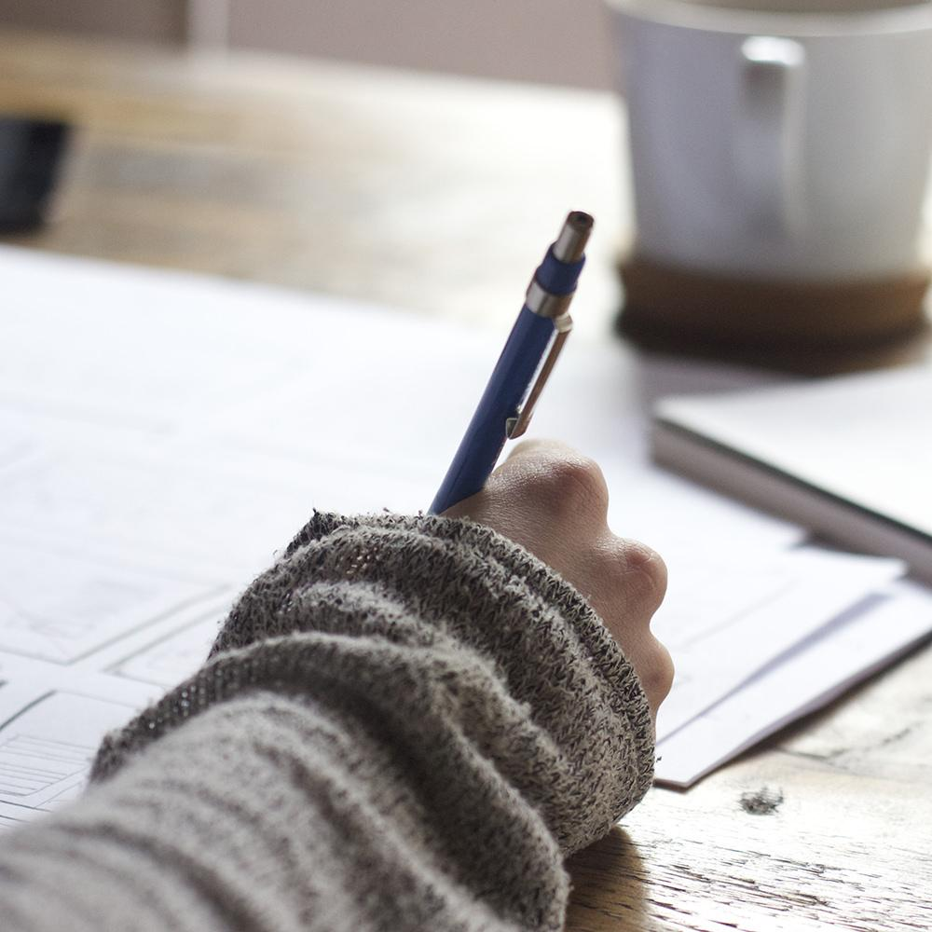
Hello!
I am Jayden Smith
I am here because I love to give presentations.
You can find me at @username

Slide 16
Quotations are commonly printed as a means of inspiration and to invoke philosophical thoughts from the reader.

Slide 17
This is a slide title
Here you have a list of items
And some text
But remember not to overload your slides with content
Your audience will listen to you or read the content, but won’t do both.

Slide 18
Big concept
Bring the attention of your audience over a key concept using icons or illustrations

Slide 19
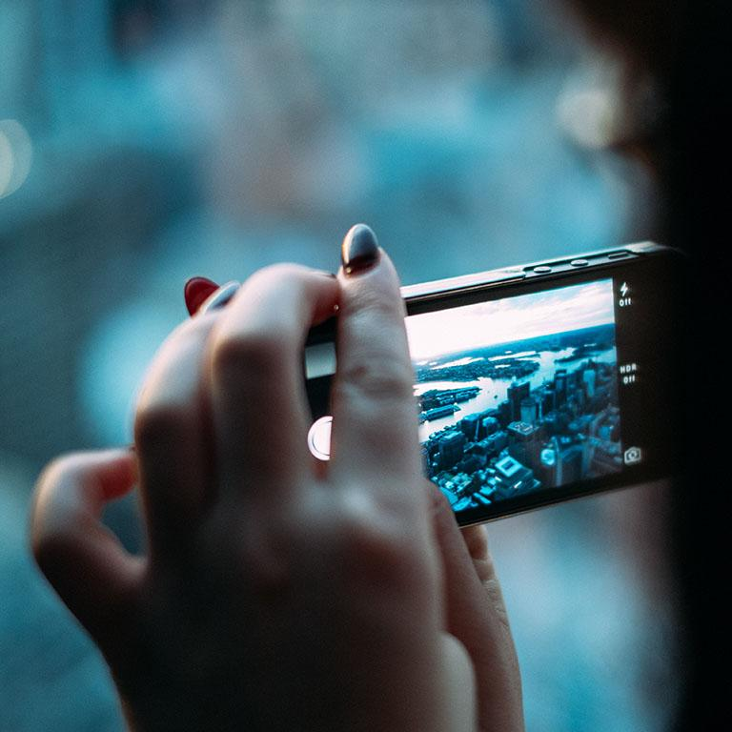
A picture is worth a thousand words
A complex idea can be conveyed with just a single still image, namely making it possible to absorb large amounts of data quickly.

Slide 20
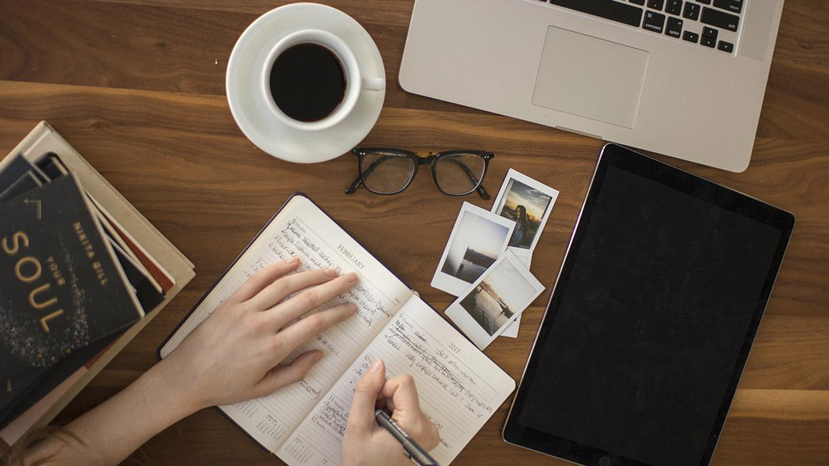
Want big impact?
Use big image.

Slide 21
Use charts to explain your ideas
Yellow
Blue
Red

Slide 22
And tables to compare data
 | A | B | C
Yellow | 10 | 20 | 7
Blue | 30 | 15 | 10
Orange | 5 | 24 | 16

Slide 23
Maps
our office

Slide 24
89,526,124
Whoa! That’s a big number, aren’t you proud?

Slide 25
89,526,124$
185,244 users
100%
That’s a lot of money
And a lot of users
Total success!

Slide 26
Our process is easy
first
second
last

Slide 27
Let’s review some concepts
Yellow
Is the color of gold, butter and ripe lemons. In the spectrum of visible light, yellow is found between green and orange.
Blue
Is the colour of the clear sky and the deep sea. It is located between violet and green on the optical spectrum.
Red
Is the color of blood, and because of this it has historically been associated with sacrifice, danger and courage.
Yellow
Is the color of gold, butter and ripe lemons. In the spectrum of visible light, yellow is found between green and orange.
Blue
Is the colour of the clear sky and the deep sea. It is located between violet and green on the optical spectrum.
Red
Is the color of blood, and because of this it has historically been associated with sacrifice, danger and courage.

Slide 28
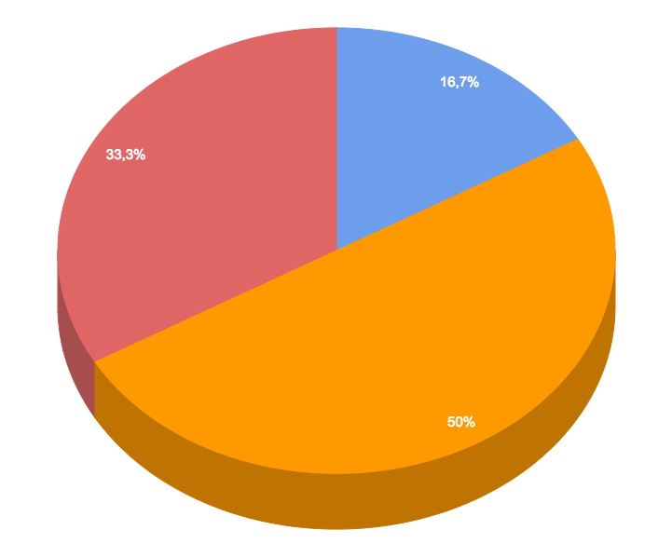
You can insert graphs from Google Sheets

Slide 29
iPhone project
Show and explain your web, app or software projects using these gadget templates.
Place your screenshot here

Slide 30
Tablet project
Show and explain your web, app or software projects using these gadget templates.
Place your screenshot here

Slide 31
Desktop project
Show and explain your web, app or software projects using these gadget templates.
Place your screenshot here

Slide 32
Thanks!
Any questions?
You can find me at @username & user@mail.me

Slide 33
Credits
Special thanks to all the people who made and released these awesome resources for free:
Presentation template by SlidesCarnival
Photographs by Unsplash

Slide 34
Presentation design
This presentation uses the following typographies and colors:
Titles: Roboto Slab Light
Body copy: Lato Light
You can download the fonts on these pages:
http://www.latofonts.com/lato-free-fonts/
https://www.fontsquirrel.com/fonts/roboto-slab
Aqua #02bdc7 · Yellow #ffb600 · Magenta #fc4067
You don’t need to keep this slide in your presentation. It’s only here to serve you as a design guide if you need to create new slides or download the fonts to edit the presentation in PowerPoint®

Slide 35
SlidesCarnival icons are editable shapes.
This means that you can:
Resize them without losing quality.
Change line color, width and style.
Isn’t that nice? :)
Examples:

Slide 36
😉
Now you can use any emoji as an icon!
And of course it resizes without losing quality and you can change the color.
How? Follow Google instructions https://twitter.com/googledocs/status/730087240156643328
✋👆👉👍👤👦👧👨👩👪💃🏃💑❤😂😉😋😒😭👶😸🐟🍒🍔💣📌📖🔨🎃🎈🎨🏈🏰🌏🔌🔑 and many more...

